Slide 1


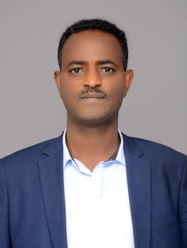
Environmental pollution in Ethiopia:
The impact of urbanization and industrialization
Alemnew Berhanu Kassegne
Associate Professor
Environmental Chemistry
Department of Environment, Room D
Thursday, February 20 at 13:00

